Slide 2
Two Rivers Public Schools
4 Buildings
Connected 10G Fiber
1700+ Students
200+ Staff
1300+ Chrome Devices
650+ Windows Devices
150+ iPads
In-House Video Over IP

Slide 3
Our previous infrastructure
Core: Cisco 4500X Fiber switches x2
Switches: Cisco 2960X 48 port POE switches w/stacking modules x29 Cisco 2960X 48 port non-POE switches w/stacking modules x16
WiFi: Cisco AIR-CAP2702i-A-K9 x53 Cisco AIR-LAP-1142N-A-K9 x52

Slide 4
Challenges we faced with previous equipment
Ongoing maintenance costs
Vendor dependency
Lack of native monitoring
Connectivity issues with Chromebooks
Poor AP mounting locations at middle/elementary schools
Not enough POE Ports at middle/elementary schools

Slide 5
Our Test Plan
Develop small, isolated Unifi Wifi network in one classroom
Classroom consists of 30 Chromebooks and one UAP
Compare connectivity reliability to other rooms with Cisco WIFi

Slide 6
Test Results
On Cisco - Devices failed to reliably connect to AP and have adequate throughput after ~15 devices connected
On UniFi - Devices all connected to UAP with no issues. - Over 70 devices connected to UAP, including staff/student personal devices (ie: phones)

Slide 7
New Infrastructure
** Our Core **
Unifi USG-XG-8
80Gbps 20k Clients 16 Cores (1.8 GHz) 16GB DDR4 Ram

Slide 8
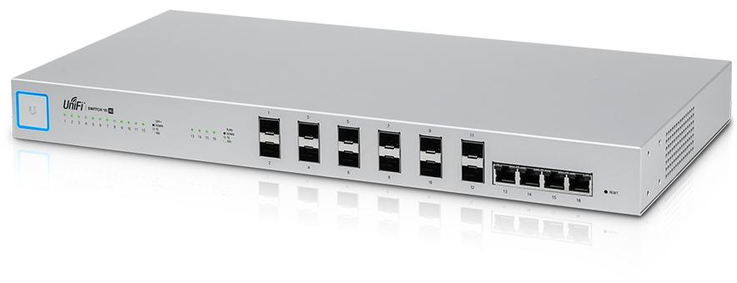
Existing New Infrastructure
** Our Core **
Unifi 16-XG SFP Switches (3)

Slide 9
Existing New Infrastructure
** Edge Switches**
US-48-750W Switches x49 Up to 70Gbps Throughput on 48 Port Units

Slide 10
Existing New Infrastructure
** Access Points **
UniFi AP-AC-PRO x134

Slide 11
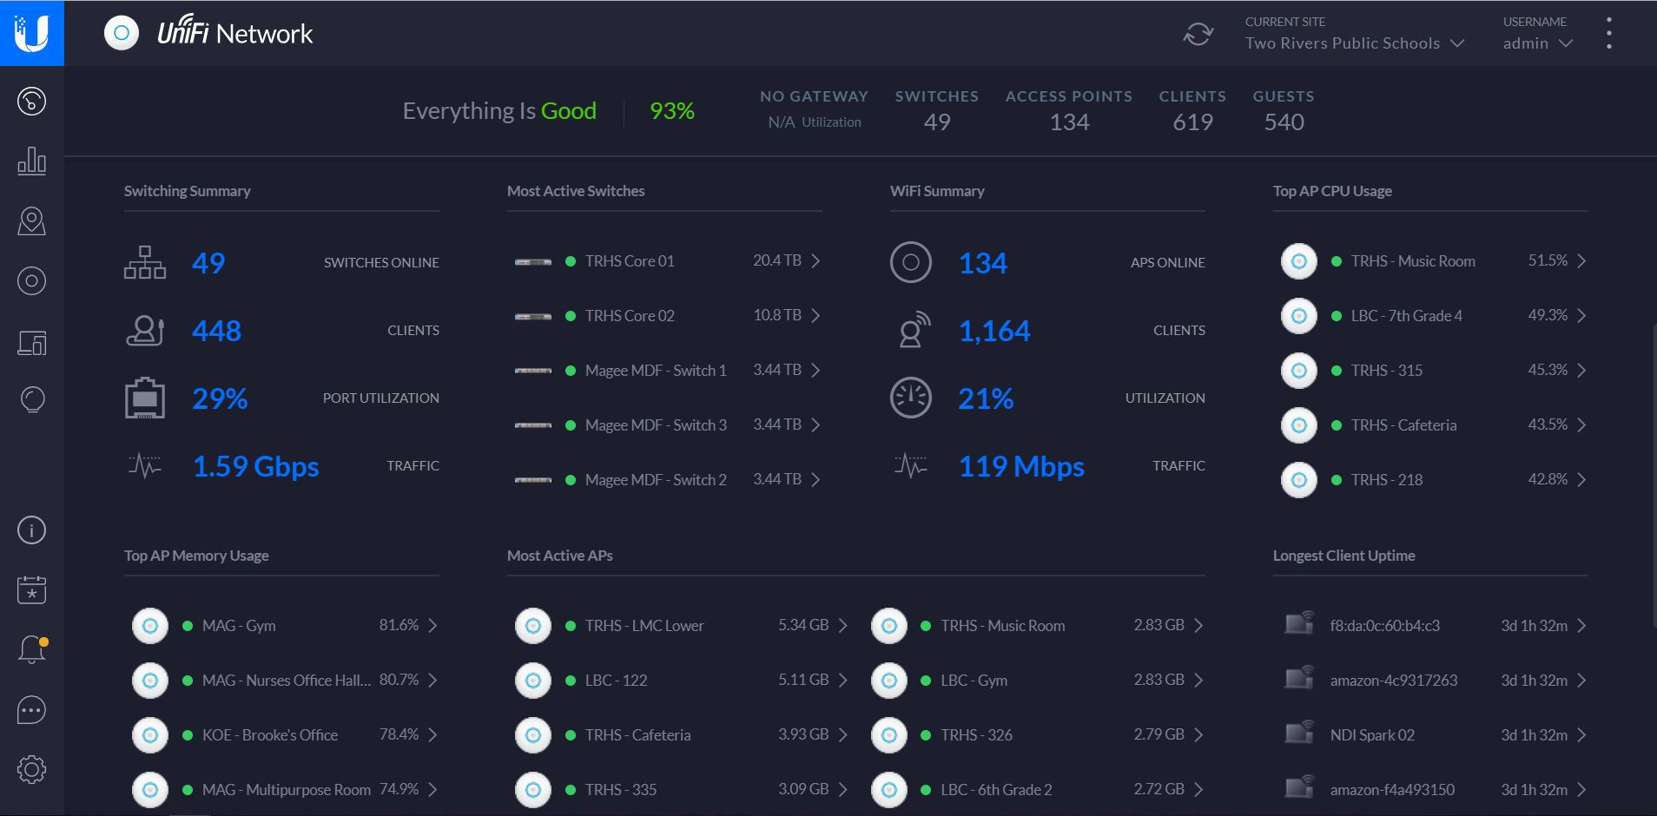

Slide 12
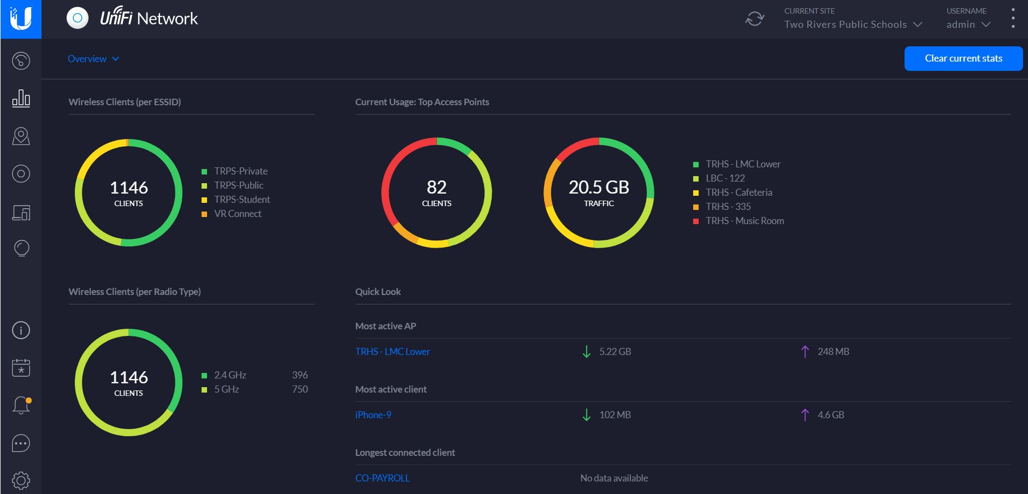

Slide 13
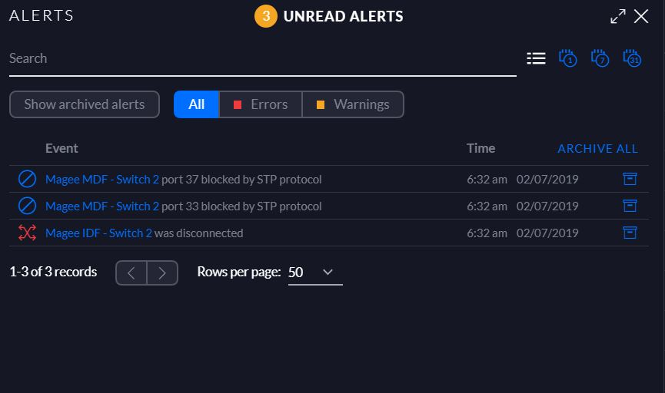

Slide 14
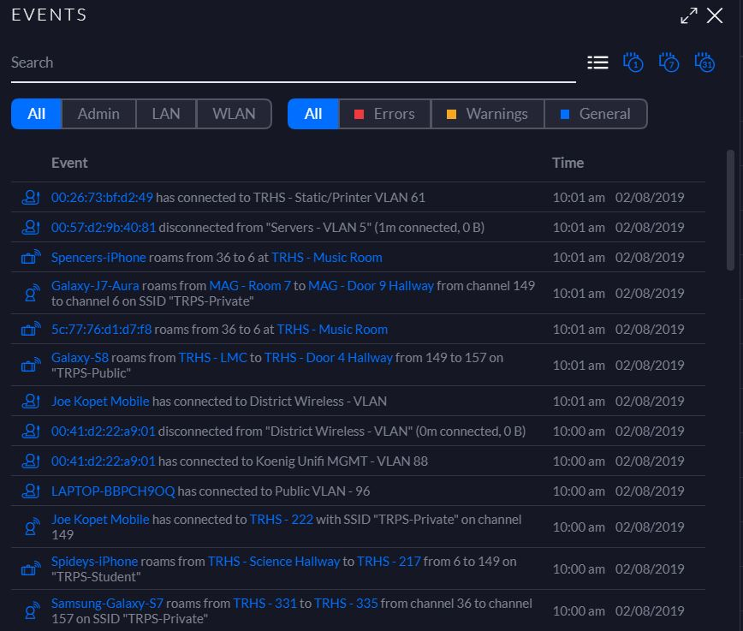

Slide 15
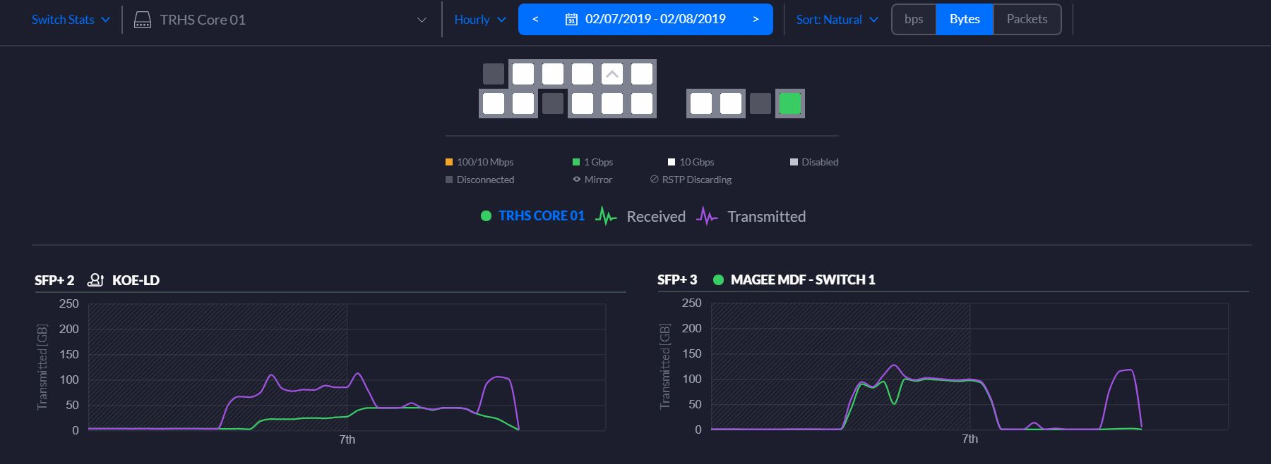

Slide 16
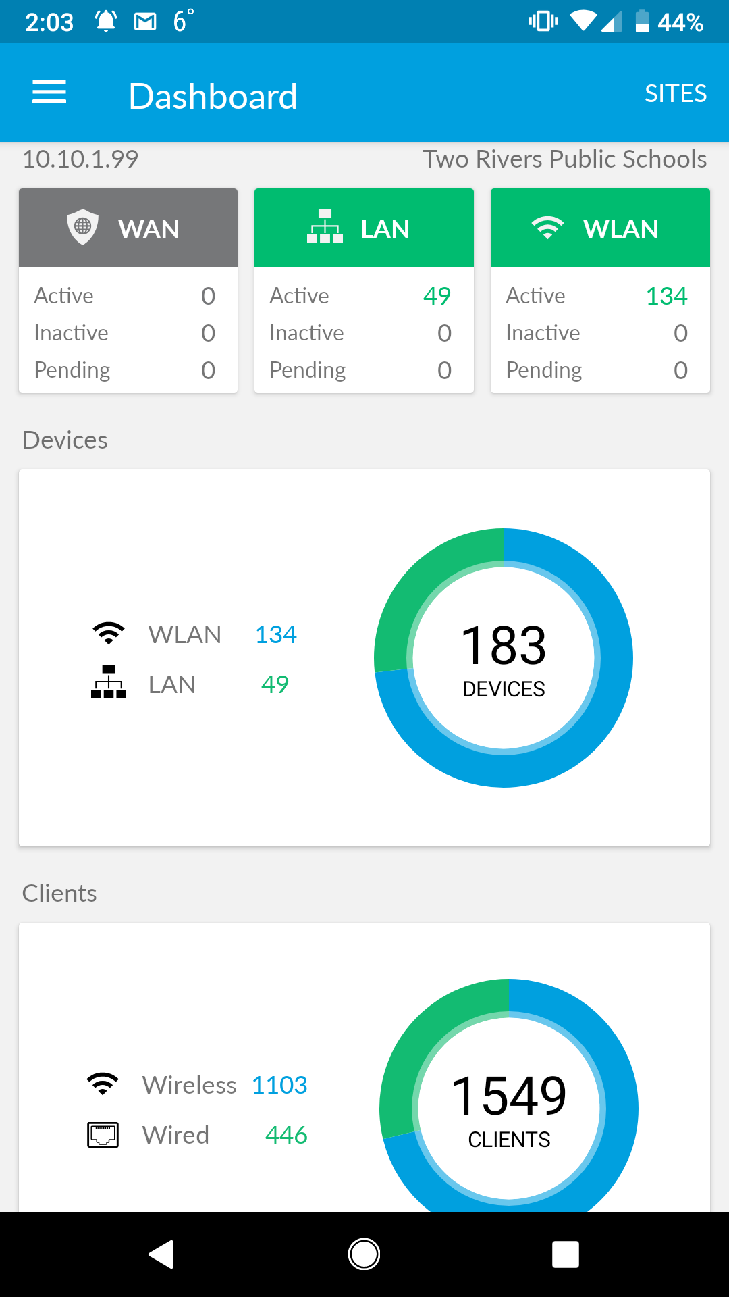
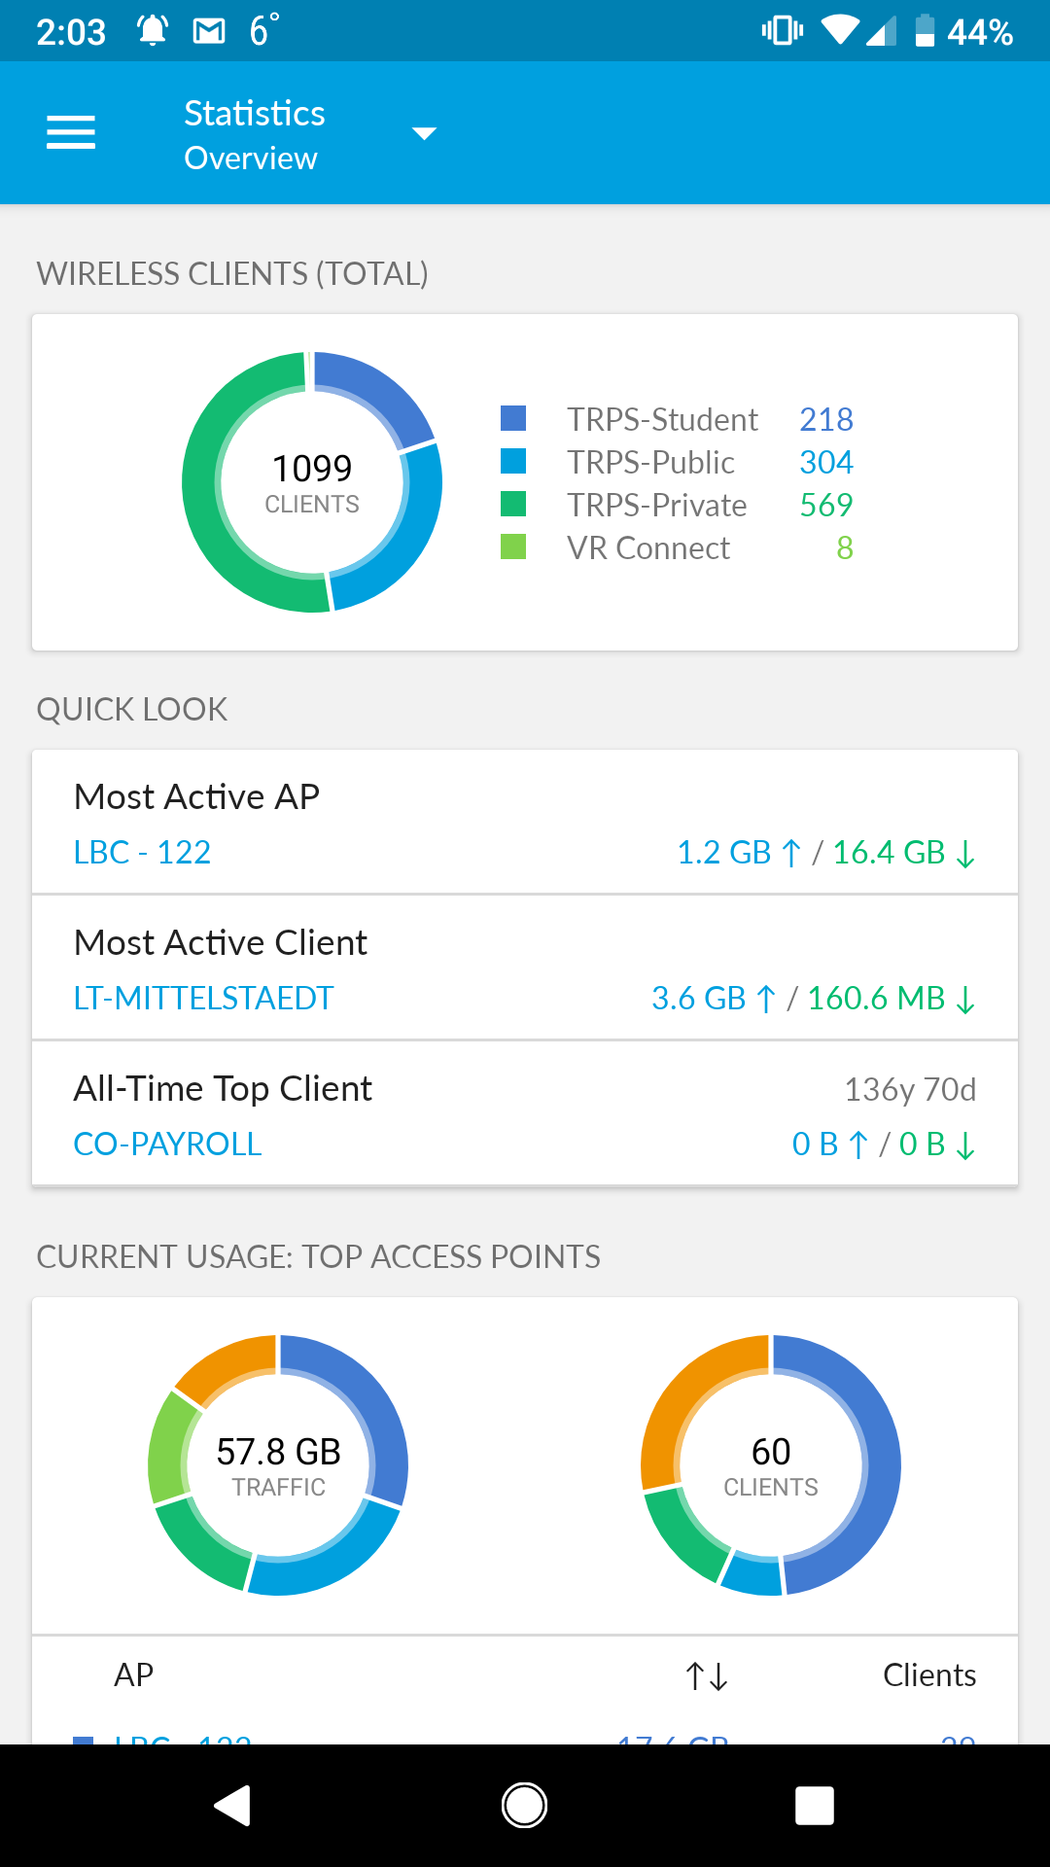

Slide 17
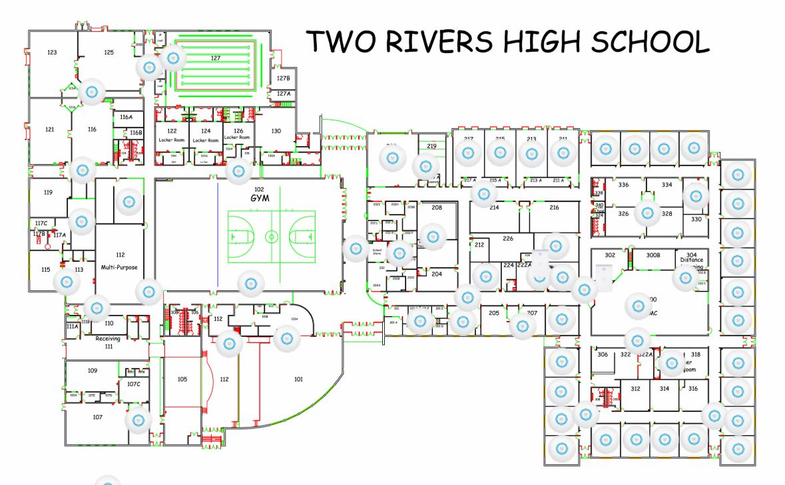

Slide 18
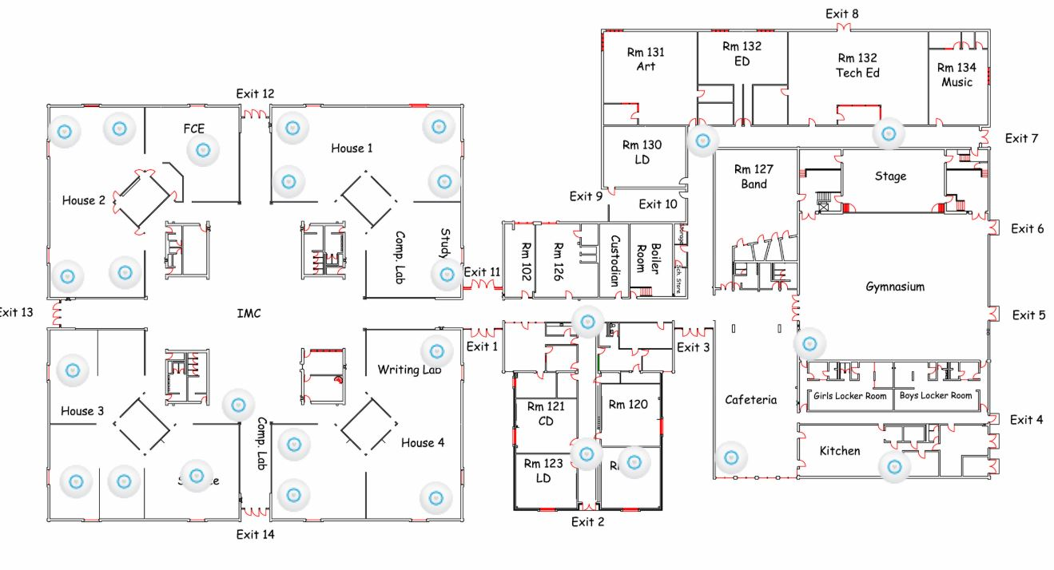

Slide 19
Implementation Challenges
Mixing infrastructure
Inconsistent local VLAN databases
Difficult management
Upgrading from edge - core instead of core - edge
Stocking issues of Ubiquiti products
Finding time
Familiarization with terminology differences

Slide 20
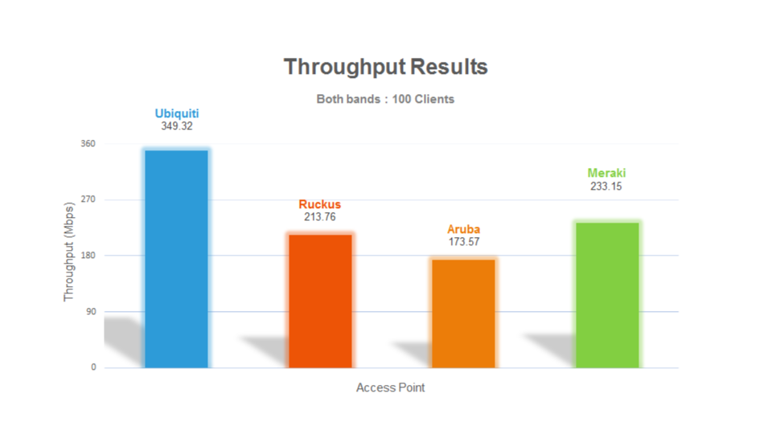
“Ubiquiti isn’t enterprise grade equipment.”
This claim has been around for a very long time. In the past few years, Ubiquiti has evolved from a solid SOHO offering to a robust enterprise solution. I will break up the debunked claim into multiple sections.
Performance: Ubiquiti ranks at the top -- or near the top -- with contenders such as Meraki, Ruckus, Aruba, etc.

Slide 21
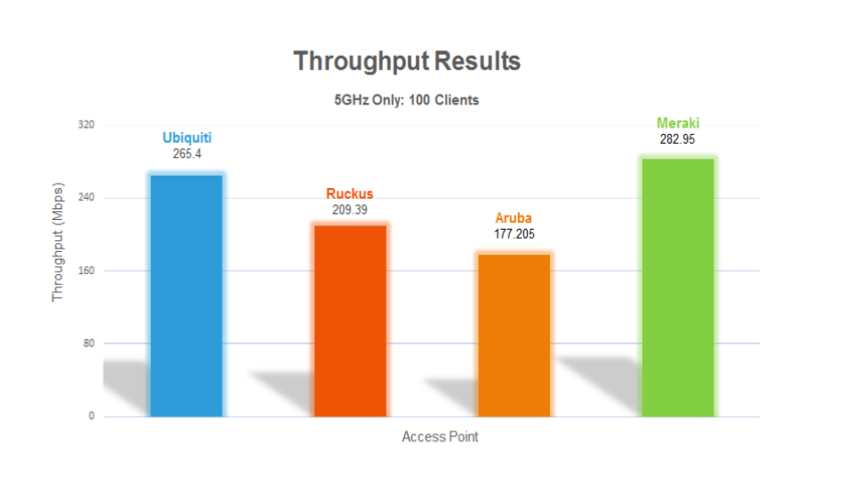
“Ubiquiti isn’t enterprise grade equipment.”
This claim has been around for a very long time. In the past few years, Ubiquiti has evolved from a solid SOHO offering to a robust enterprise solution. I will break up the debunked claim into multiple sections.
Performance: Ubiquiti ranks at the top -- or near the top -- with contenders such as Meraki, Ruckus, Aruba, etc.

Slide 22
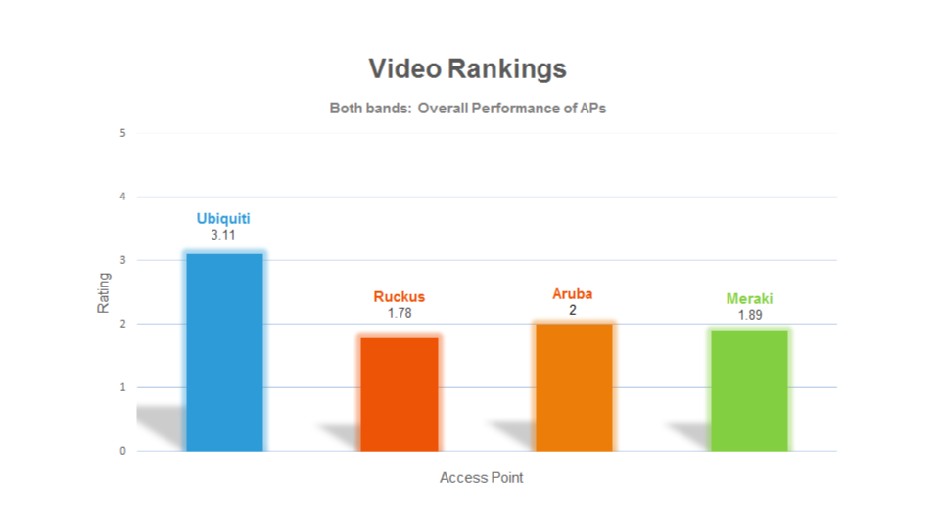
“Ubiquiti isn’t enterprise grade equipment.”
This claim has been around for a very long time. In the past few years, Ubiquiti has evolved from a solid SOHO offering to a robust enterprise solution. I will break up the debunked claim into multiple sections.
Performance: Ubiquiti ranks at the top -- or near the top -- with contenders such as Meraki, Ruckus, Aruba, etc.

Slide 23
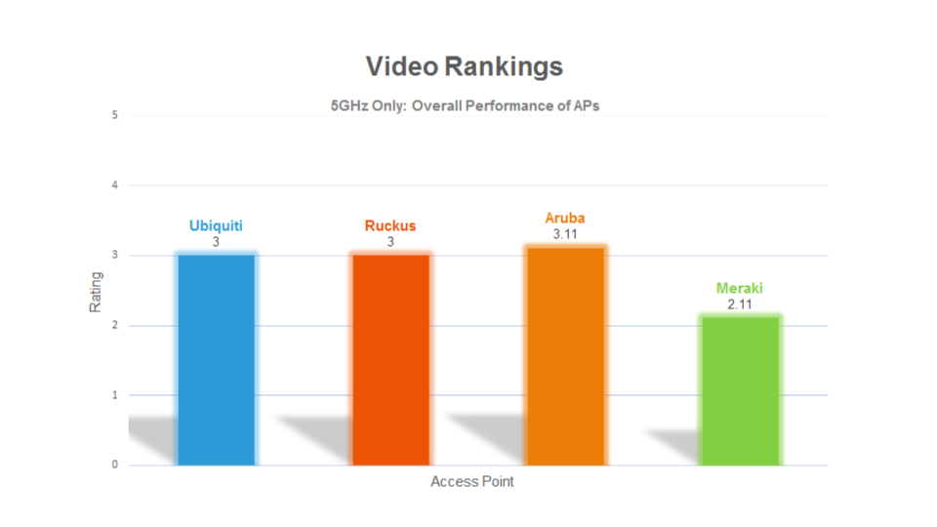
“Ubiquiti isn’t enterprise grade equipment.”
This claim has been around for a very long time. In the past few years, Ubiquiti has evolved from a solid SOHO offering to a robust enterprise solution. I will break up the debunked claim into multiple sections.
Performance: Ubiquiti ranks at the top -- or near the top -- with contenders such as Meraki, Ruckus, Aruba, etc.

Slide 24
All credit goes to https://alethea.in/wifi-performance-benchmark-testing-class-room-environment/
For performing this test and providing the visual graphs. For the full detailed report visit https://alethea.in/wp-content/uploads/Ubiquiti_HD_Test_Report.pdf
The best way to test performance is to buy a Ubiquiti product, install it in your network, and do some benchmark tests.
Feature set: Ubiquiti contains most of the features included with other enterprise solutions. The full feature list for all of their products is too extensive to list in this document. Consult a product white paper to learn more.
We haven’t run into a feature that we used to have that we don’t have now. Every firmware version improves or adds additional functionality.
Hardware reliability: The hardware inside Ubiquiti products is far from “cheap.” For 2.5+ years since our deployment, we haven’t run into a single hardware failure. The cost to replace a defective device is a mere fraction of a competing brand. There is also no license or extended warranty cost so in all aspects maintaining the hardware is significantly cheaper.

Slide 25
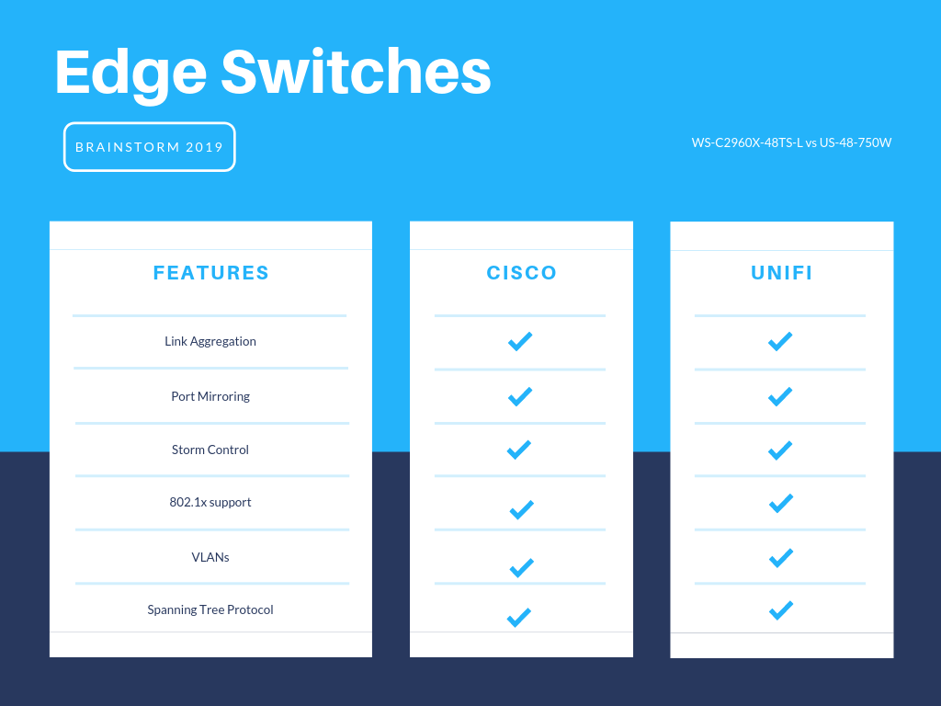
Switch Comparison

Slide 26
“There is no support for these products.”
Ubiquiti offers online chat support at no additional cost via the Unifi Controller. The chat support has come a long way in quality. Also, Ubiquiti has an enormous online forum support community. If you still aren’t comfortable with that and need phone support there is a paid option called Unifi Elite. I don’t recommend Unifi Elite for a number of reasons:
A total network outage doesn’t happen without a root cause. Implement best practice standards:
Have an isolated test environment separate from your production environment. Thoroughly test new firmware versions in the test environment before putting it into production - Run iPerf tests, packet capture, uptime metrics, etc.
Always keep a spare device for mission critical equipment such as your core switches or central USG.
Implement and test spanning tree to prevent network loops.
Document all topology changes. Perform topology changes outside of production hours.
2. The cost for the service isn’t justified. The equipment is so inexpensive that a device contract is unnecessary.

Slide 27
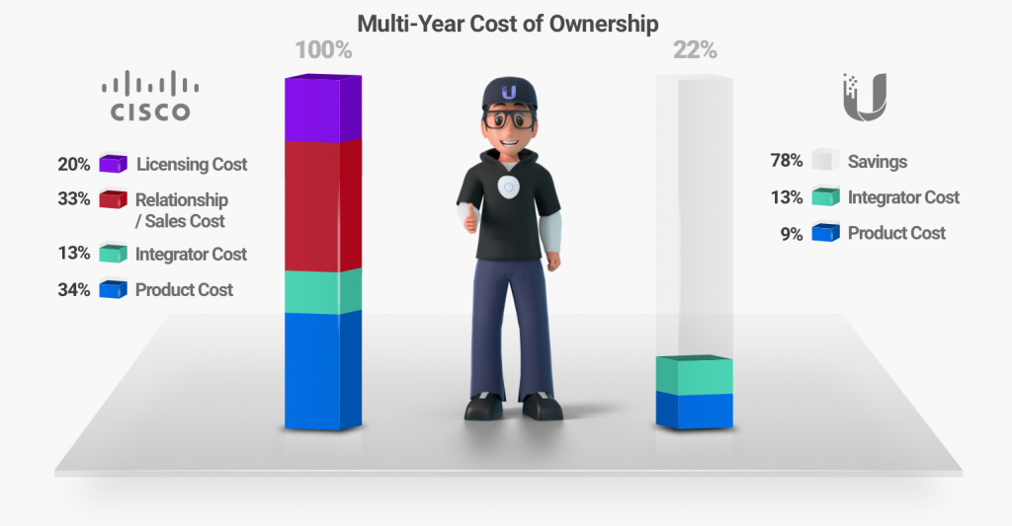
“How are the products so cheap? Does low price = low quality?
Ubiquiti doesn’t have the massive employee headcount of competitors. In fact, a majority of their staff is involved with developing the product rather than selling the product. Ubiquiti relies on word of mouth above all else. I have provided an excellent infographic and article:
https://community.ubnt.com/t5/UniFi-Updates-Blog/Is-UniFi-cheap-or-is-everyone-else-over-priced/ba-p/448637
Note: All credit goes to Ubiquiti for making this infographic.

Slide 28
Total Cost Savings
Approx 80-85% cost savings according to our calculations
Ubiquiti infographic claims a 78% cost saving rate

Slide 29
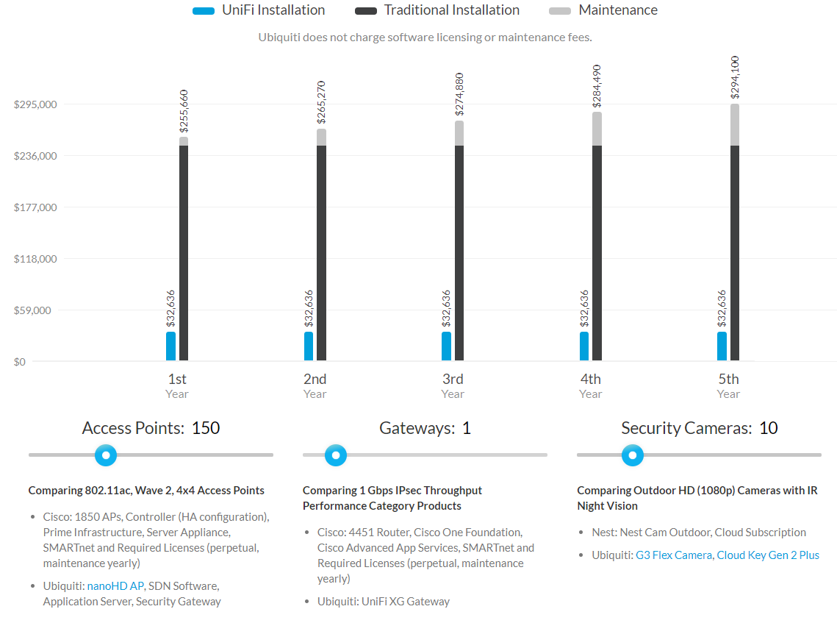
Ubiquiti Claims…..

Slide 30
Oh yeah, also…...
Unifi Cloud Key is unreliable over 25 devices
Unifi does offer free controller software for both Linux & Windows
Software controller can be a resource hog
Ours is 16 core / 18GB Ram running Linux on AHV (Nutanix)
You can schedule firmware updates ahead of time
Schedule hardware reboots is not currently available - Feature request submitted
Ubiquiti does make MM/SM SFP+ modules
20pk of MM $360 MSRP ($18/ea)
20pk of SM $750 MSRP ($37.50/ea)
Do not work in Cisco SFP/SFP+ ports
Unifi SFP/SFP+ ports are 3rd party compatible ie: Axiom
Mobile app for Unifi controller works very well and comes in handy
iOS / Android
Why Unifi?
https://www.ui.com/why-unifi/

Slide 31
Thank you for attending our presentation
Austin & Joe
Link to this presentation
https://tinyurl.com/ya4ltero
Austin Schroeger
IT Director
Two Rivers Public Schools
austin.schroeger@trschools.k12.wi.us
Joe Kopet
Network Engineer
Two Rivers Public Schools
joe.kopet@trschools.k12.wi.us

